Slide 1



PROPOSAL–PRODUCT BENCHMARK STUDY– A SELECTED ORGANIZATION
Prepared For
Prepared By
MARKET INTELLIGENCE . CONSULTING
www.techsciresearch.com
September 21 , 2022
TSR/2022/486

Slide 2
Proposal Flow
Contents
Background…………………………………………………………………………………………………………………………………….................3
Scope of Work……………………………………………………………………………………………………………………………………………..4
Research Methodology…………………………………………………………………………………………………..............................................9
Project Execution Plan……………………………………………………………………………………………………………………………..........11
Project Deliverables………………………………………………………………………………………………………………………………………12
Project Organization………………………………………………………………………………………………………………………………………13
Communication Plan………………………………………………………………………………………………………...........................................14
Investment Figures………………………………………………………………………………………………………………………………………..15
About TechSci Research……………………………………………………………………………………………………….……………….............16

Slide 3

Background
Global Information, Inc. (GII) is a leading search engine, offering access to the largest online collection of industry, company and country reports available. The company is involved in providing research assistance services to various industries globally. The company’s services are used by some well renowned customers worldwide. GII has over 23 years experience serving clients worldwide with delivering reliable information to multinational client.
One of the client of GII intends to do project benchmarking of a selected organization .TechSci is submitting this proposal covering scope of work, methodology, timelines and other details

Slide 4

SCOPE OF WORK

Slide 5

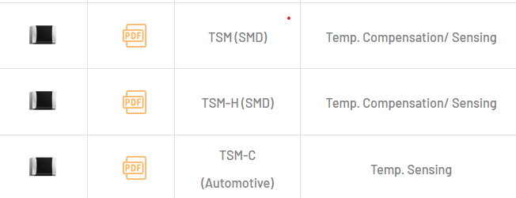
Scope of Report
Target Company: Thinking Electronic Industrial https://www.thinking.com.tw/index.php
Thinking Electronic Industrial Co., Ltd. provides a broad line of protective circuit components, including over-voltage protection, over-temperature protection, and over-current protection. The product portfolio offers negative temperature coefficient thermistor (NTC thermistor), zinc oxide varistors (MOV), ceramic positive temperature thermistors (PTC thermistor), polymer positive temperature coefficient thermistors (Polymer PTC resettable fuse), temperature sensors, and gas discharge tubes.
Target Product Categories Among NTC THERMISTOR
TSM(SMD)series
TSM-H(SMD)series
TSM-C(Automotive)series)
https://www.thinking.com.tw/product_info.php?id=33&brand=NTC THERMISTOR

Slide 6
Table of Contents
S. No. | Contents | Contents
1. | Research Methodology | Research Methodology
2. | Executive Summary
3. | Financials | Global Electric Steel Market Outlook (2015-2025)
 | 3.1. | Company’s Basic Situation ( HQ, Geographical Presence, Product Offerings,
 | 3.2 | Corporate Development History: Key Milestones
 | 3.3 | Financial Report : Medium Term Sales Target (2025)
 | 3.4 | Operating Revenue Status by product and market: Overall Sales , Sales of Target Product Series ,2021
 | 3.5 | Investment Plan
4. | Productive Capacity | .
 | 4.1. | Total Production Capacity Of Each Plant: Production Area, Number Of Buildings, Whether The Line Is Mixed With Another Product Line Or Not
 | 4.2 | Investment In New Plants
5. | Development Policy | .
 | 5.1 | Materials Research And Development Site And Future Plans
 | 5.2 | Product Development Trend
6. | Human Resources | Global Electric Steel Market Outlook (2015-2025)
 | 6.1. | Composition Of Corporate Organization
 | 6.2 | Distribution Of Key Personnel: Direct/Indirect Ratio, Headcount Breakdown By Division (By Product ) Headcount Breakdown By Factory
 | 6.3 | Social Background Of Senior Corporate Management
 | 6.4 | Corporate Development Department Personnel Status
 | 6.5 | Specialty Distribution And Foreign Technical Experts
 | 6.6 | Number Of Employees At Each Plant: Whether Or Not The Product Is Cross-linked With Another Product.
 | 6.7 | Factory Wage Structure: Direct/Indirect Salary Structure
Information To Be Developed

Slide 7
Table of Contents
S. No. | Contents | Contents
7. | Sales Network | .
 | 7.1. | Corporate Sales Network
 | 7.2 | Characteristics Of Sales Composition :Sales By Customer, Region, And Market.
8. | Priority Markets And Products | .
 | 8.1. | Priority Development Markets
 | 8.2 | Priority Sales Products
9. | National Support Policies | .
 | 9.1. | Impact Of Government Subsidies On Businesses: Particularly, The Expected Impact Of The "Action Plan For The Development Of The Basic Electronic Components Industry"
10. | Competitive Strategy | .
 | 10.1. | Market Share (2021) And Medium (2023) To Long Term (2025) Target Share
 | 10.2 | Benchmark Peers By Market By Product
11. | Product Research | Product Reach
 | 11.1 | Status Of Major Facilities: Number Of Units, Vendors
 | 11.2 | All Technical Staffing Status
 | 11.3 | Productive Capacity: Production Capacity By Plant. .
 | 11.4 | Work Shift Organization Status: Operating Days, Hours.
 | 11.5 | Yield Change: Good Rate Trend
 | 11.6 | Sales Results And Major Customers: Sales And Sales Volume By Size
 | 11.7 | Cost Price : Manufacturing Cost Reduction Plans And Measures
12. | Conclusions
Information To Be Developed

Slide 8
Queries
New Products and Services Planned (p.11-12)
Is it possible to list each items in chronological order? New products are to be introduced in the next two to four years
Is it possible to express where you are focusing your efforts, such as the weighting of each items, resource allocation, etc.?
The company focuses primarily on the development of NTC Thermistor and automotive, 5G end-use applications.
Corporate Sales Network (p.17)
They are not sure if you mean that “Resistor Manufacturers” is Thinking Electronic Industrial?
The client understood that they procure raw materials, metal oxide, etc. which is on upstream of Resistor Manufacturers for production, but to what extent does TEI get involved in raw material production ?
Made changes in the final report
Manufacturing Cost Reduction (p.18)
Do you have any specific information on where in particular they are focusing on cost reduction efforts in each of these areas?
The cost reduction plans and measures are applied across supply chain and in factories.

Slide 9
Table of Contents
Note :
Information Areas are subjective and overlap with the Overall Company and target Product Categories Level. The client confirms that where it cannot be separated, it is OK to set the company as a target, whereas their vital interest remains in targeted product categories.
Text Highlighted in Blue are those Information Areas which might fall in both categories (Overall Company and target Product Categories Level.) based on the understanding at this stage. It may vary depending on the project research stage as per the characteristics and set-up of the target organization
Some data points/ Information Areas related to Product Categories level would be having shared infrastructure/resources. In that case, an estimate would be developed on a best-effort basis.
Output and Granularity will vary depending on the characteristics and set-up of the target organization/ target Product Categories
Disclaimer : TechSci will cover the required set of information in the best possible manner. We assure you that we will develop a significant level of information to meet the research objective. However, the level of granularity may vary as some of the pre-defined information areas are open-ended, and responses will vary as per the target company's actual practices, including the fact that the information required is sensitive and confidential
Disclaimer : The copyright of the study will remain with the end client.
Information To Be Developed

Slide 10

RESEARCH METHODOLOGY

Slide 11









Research Methodology
The recommended methodology for this study is based on exhaustive Secondary Research followed by extensive Primary Research. TechSci Research will deploy a dedicated team who will work dedicatedly for the Client to meet research objectives.
Phase-I: Secondary Search: The team will conduct exhaustive secondary research to collect the information on required set of data /information.
Phase-II: Formulating Questionnaire & Developing List of Respondents : Post Secondary Search, TechSci will prepare a list of target individuals in target organization, across different functions and levels. In-addition, TechSci will also identify individuals in distributors, participants in the supply chain , competitor companies, etc.
TechSci team will formulae guidelines to ask specific questions related with the project objectives.
Phase-III: Extensive Primary Search : TechSci Research will execute primary surveys targeting identified individuals in target organizations including their competitors' distributors, participants in the supply chain , through Telephonic methodology. TechSci Research will perform periodical checks on data collected through telephonic surveys with logic checks and analyze survey results.
Phase IV:
TechSci will deliver the final comprehensive project report in detailed PDF format.
Target Audience Identification
Questionnaire Design and Finalization
Survey Execution
Data Cleaning and Validation
Survey Analysis
Reporting

Slide 12
Project Execution Plan
Interim Report
Final Report
Weeks With | 1 | 2 | 3 | 4 | 5 | 6 | 7
Project Initiation
Project team set-up
Project kickoff meeting with key stakeholders
Content and report generation
Secondary Data collection & research
Template development
Contact list development
Develop and validate the discussion guide
Primary interviews among all industry participants
Collect and validate data from primary data source
Report writing
Analysis & Deliverable
Interim deliverable
Final deliverable
Completion & Follow up
Note:
The above-mentioned timelines do not include time required by Client’s/GII management for approval of questionnaires, feedback on interim reports, setting up meetings between Client/GII and TechSci Research because it would depend upon the availability of Client’s/GII management.

Slide 13
Project Deliverables
SCHEDULE OF DELIVERABLES:
Format | Deliverable type | Total Timeline (in weeks)
PPT/PDF | Interim report | 4
PPT / PDF | Final report | 7
Teleconference at commencement of the study, where the client/GII will confirm the research outline and finalize dates.

Slide 14
Project Organization
GII Contact
Name | Project Role | Contact Information
Tomohiro Kadosaki | Project Coordinator | Email: kadosaki@gii.co.jp
TechSci Research Contact
Name | Project Role | Contact Information
Ms. Sukriti Seth | Project Coordinator | Mob: +91 9910541344
 |  | Tel: +91.120.452.3907
 |  | E-mail: Sukriti.seth@techsciresearch.com
Mr. Vikas Yadav | Consultant | Mob: +91 9560913535
 |  | Tel: +91.120.452.3954
 |  | E-mail: vikas.yadav@techsciresearch.com

Slide 15

Communication Plan
Our communications plan consists of a series of planned communications (both written and verbal) – to make certain that all parties are kept fully informed during project. In addition to these planned communications, ad-hoc communications will occur throughout the project; using email, phone, and instant message for this purpose. Contact information for the Client and Supplier Research Consultant will be finalized during the study kick-off.
Project Kick-off: At the beginning of the project, Supplier will conduct a conference call with the company, which we refer to as the Project Kick-off. The purpose of this meeting is to discuss the scope of the project thoroughly. In this discussion, we will finalize the project objective, scope, methodology, deliverable format, project schedule including any interim deliverables, and communications plan, and their schedule and process.
Project Status Report: Supplier will prepare an overall project update on a regular (generally once a week) basis. This will be written in email format and will include an overview of the status of the project and the immediate action points. The days and timings of the Project Status Report and subsequent Project Status Conference Calls will be decided upon during the Project Kick-off.
Project Status Conference Call: The Project Status Conference Calls are held on a scheduled basis (generally weekly) the day following receipt of the Project Status Report. During these discussions, supplier and client review the status of the project and address any issues that may have arisen.
Project Status Conference Call Summary: After each Project Status Conference Call, Supplier will send a summary of the discussion to all the participants via email.

Slide 16
Investment Figures
TechSci Research estimates that total investment figure is:
Scope | Investment, excluding GII Margin
PRODUCT BENCHMARK STUDY– A SELECTED ORGANIZATION | USD 10,000
The above-mentioned price includes all the elements involved in conducting project, such as project preparation, questionnaire designing, primary research, time spent on desk research, project reporting and project deliverables.
PAYMENT SCHEDULE
Stages | Payment Schedule | Payment, US$
Overall Project Scope | Initiation of the study | 50%
 | Final report submission | 50%

Slide 17

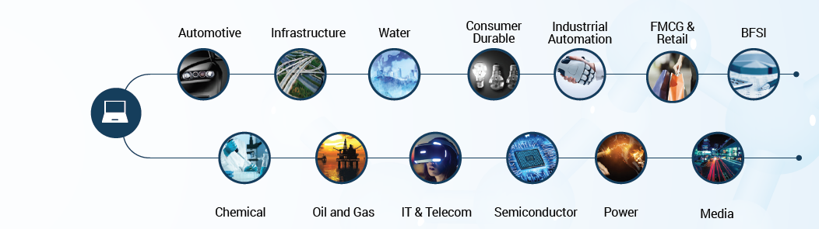
WE ARE TECHSCI RESEARCH
A global market research and consulting company focused on providing research and consulting services worldwide, spanning a range of industries.
We deliver our customers with high value market research and advisory services to identify new market opportunities, growth engines and innovative ways to capture the market. We support leading organizations for meeting strategic business goals and making informed business decisions.
www.techsciresearch.com
11
1000
+
+
Industries
Successful Projects
80
150
+
+
Countries
Professionals
AREAS OF FUNCTIONAL EXPERTISE

Slide 18
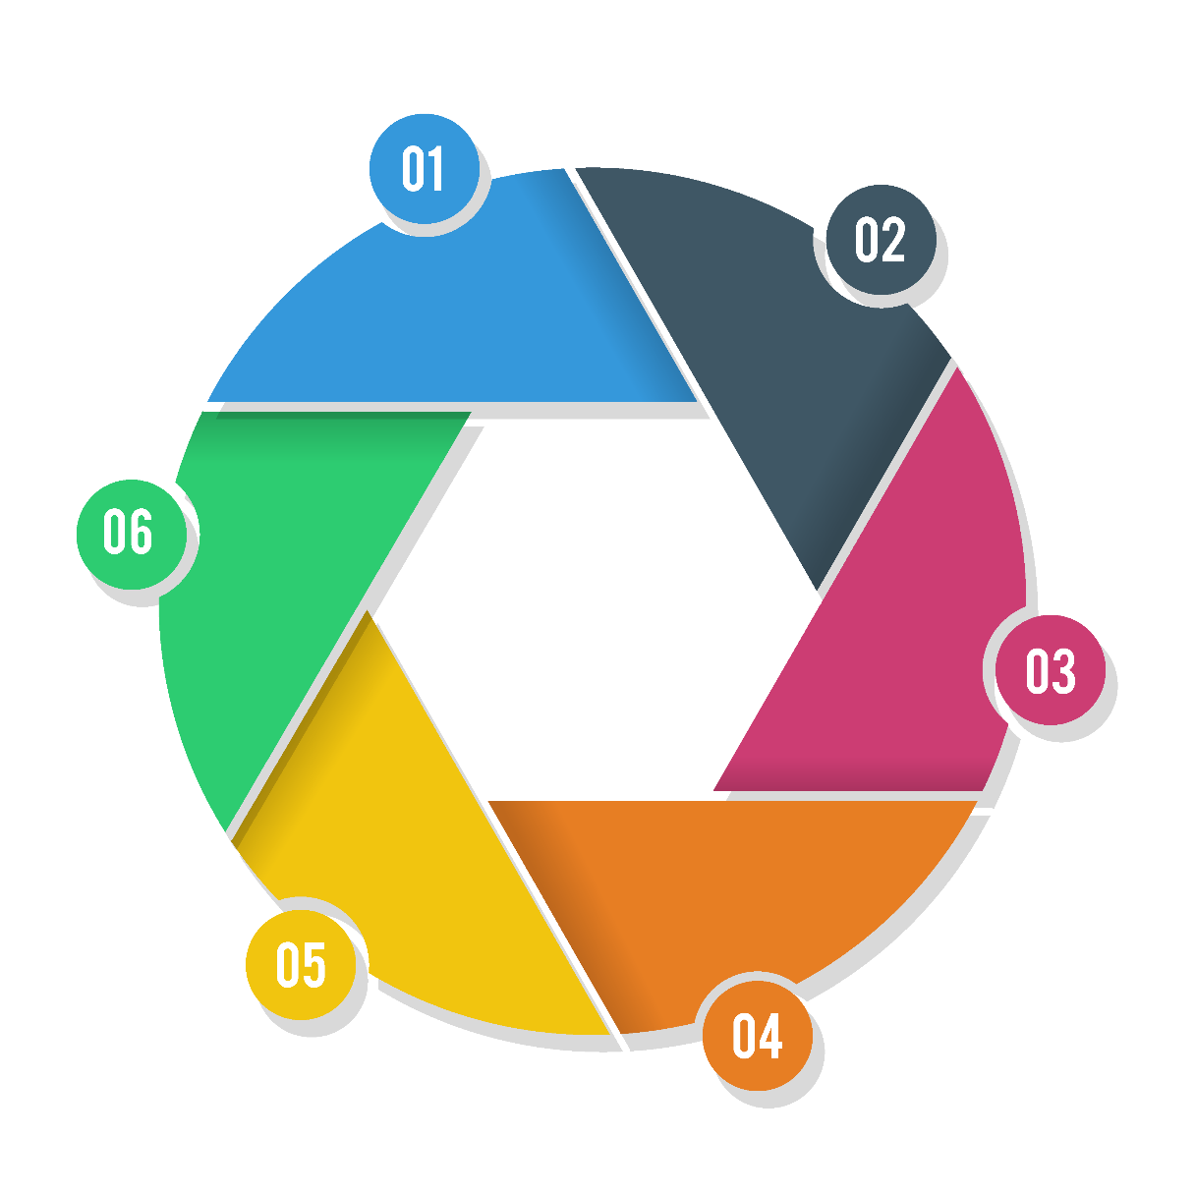






RESEARCH OFFERINGS ACROSS VALUE CHAIN
Market Landscaping
Need Gap/Pain Point Analysis
Market Size Estimation
Market Forecasting
Market
Exploration
Market
Potential
Pre & Post Communication
Advertising Effectiveness
Event/Promotion Effectiveness
New Product Testing
Price Sensitivity
Market Segmentation
Positioning &
Communication
Product and solution Development / Launch
Market
Response
Competitor
Tracking
Customer Satisfaction/ Tracking
Usage & Attitude
Brand Perception/ Tracking
Consumer Behavior Studies
Consumer/Shopper Insight
Competitive Intelligence
Competitors Profiling
Competitive Benchmarking

Slide 19
ROBUST RESEARCH MODEL
TechSci leverages a next-generation research model that fully harnesses new technologies and processes to streamline operations, automate research procedures and deliver insights in more interactive and engaging formats. Our cutting-edge research model leverages the following engines of innovation to deliver unique research value:
Offshoring - By tapping the capabilities of highly skilled professionals in emerging countries and supplementing the team with client-facing analysts in strategic worldwide locations, we cultivate a lower cost yet highly specialized, flexible and knowledgeable research team.
Industry Focus – With independent teams of experts in various industry sectors we keep a bull’s eye on the industry. Our team to specialize as experts in their domain, which combined with our research model, helps to deliver more value to our clients.
The Internet - The explosion of information transparency and availability enabled by the Internet provides an unprecedented tool for research innovation.
Technology – TechSci Research invests heavily in technology and maintains one of the industry’s highest technology employee-to-analyst ratios, enabling us to process information more quickly and deliver insights in more interactive and useful formats.

Slide 20
TECHSCI ADVANTAGE
More Market Research Value - Our prices are generally 35-60% lower than traditional market research providers for work our clients indicate is of equal or better quality, so our clients are able to increase their market research coverage without increasing their budget.
Speed & Flexibility - We harness the power and flexibility of our research model to deliver information faster and update data more frequently. Our clients benefit from unique solutions that can fit their company-specific market research needs.
Improved Research Efficiency & Utilization - Our model can help to increase the efficiency of internal market research divisions by helping our clients stretch their existing company resources and budget.
Comprehensive Coverage of Under-Researched Areas -TechSci's Research model enables us to profitably engage in projects focused on emerging markets and to cover exciting new markets and under-researched areas faster.

Slide 21









ENGAGEMENT AND EMPANELMENT
TechSci has the exposure of working with organization working towards the development of different sectors and country markets. Below are few organizations for whom TechSci worked / empaneled to meet their research needs across different geographies

Slide 22





























OUR REPRESENTATIVE CLIENTS

Slide 23
TESTIMONIALS
It was indeed a very good experience .TechSci was able to provide us with all the details that we were looking in the study. A special thanks to the team for the strong support throughout the entire product launch journey.
Mr. Vivek Chopra
Product Development Team
Panasonic India Pvt. Ltd.
Given the objective of the report was to understand overall opportunity landscape of Sensors, a more detailed explanation of the manufacturing process, value chain activities and player landscape have attributed higher value to the report.
Mr. Sameer Seth
Corporate Strategy
JK Organization
Market
Exploration
Market
Potential
Positioning &
Communication
I am satisfied with overall performance of TechSci Research. Weekly updates before the final report were especially helpful and reassuring. Additional requests on the content of the interim and/or final reports were handled in a swift and professional manner.
Mr. Shin Dosho,
Member Board of Directors,
Osaka Gas Co. Ltd
It’s a good piece of information when the company doesn’t have any information in the market as it combines qualitative & quantitative data. This why if I’m tasked to find data on an unknown market, I would probably contact you back.
Mr. Thomas Wiegele
Marketing Strategy
BSH Home Appliances
Product and solution Development / Launch
The quality of report was very good. The amount of time taken for the 10% free customization was a little long. The response was excellent.
Manager – Strategy
Shapoorji Pallonji and Co. Ltd.
Market
Response
Competitor
Tracking
I admit that TechSci’s in-depth knowledge on the market and cooperation with face-to-face meeting was very helpful.
Mr. Eugene Kim
Financial Planning Division
LG Electronics

Slide 24
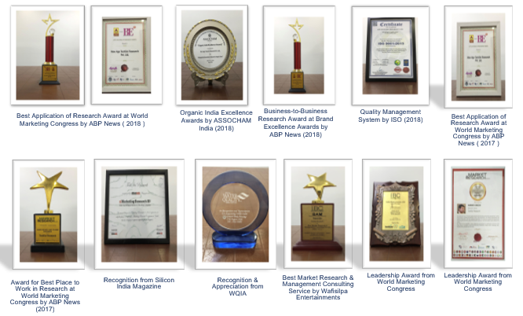
AWARDS & RECOGNITIONS

Slide 25

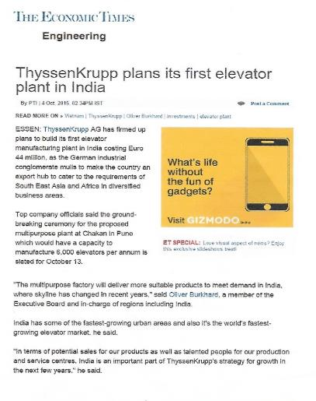
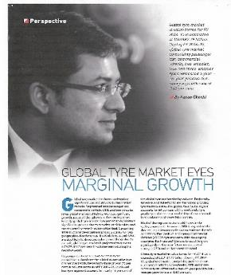
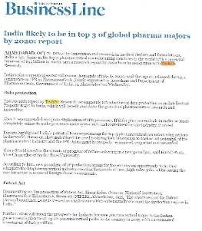
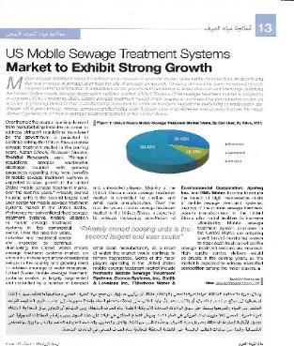


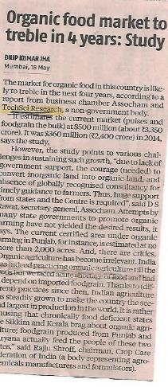
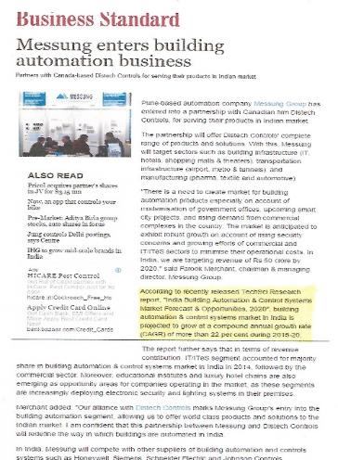
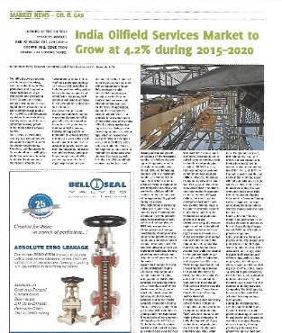
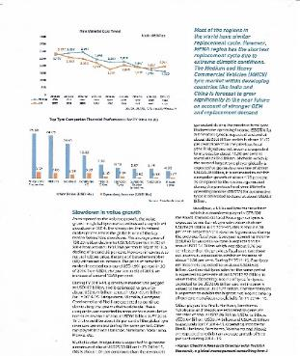





TECHSCI IN MEDIA
Our research findings have been widely covered by most prestigious and credible media houses across the world.

Slide 26







CONTACT US
TechSci Research – North America
2950, Boundary Road, Burnaby, British Columbia, Canada
Tel: +1- 646- 360-1656
E: sales@techsciresearch.com
TechSci Research – Europe
54, Oldbrook, Bretton,
Peterborough,
United Kingdom
E: sales@techsciresearch.com
TechSci Research – Asia-Pacific
B-44, Sector -57, Noida, National Capital Region, UP, India
Tel: +91-120-4523900
E: sales@techsciresearch.com
TechSci Research
Cyber City, Building No. 8C, Gurgaon, National Capital Region, Haryana, India
Tel: +91-124-6428661
E: sales@techsciresearch.com
www.techsciresearch.com
INDUSTRY ASSOCIATIONS
The information contained herein is of a general nature and is not intended to address any particular situation, individual or entity. No one should act upon such information without appropriate professional advice.
2018 © TechSci Research All Rights Reserved.

